Slide 1

BLE Mouse Using Capsense Proximity Shield
Project by: Alexis Adie
ELC343-L2
12/7/17

Slide 2
Project Requirements
Successfully connect PSoC BLE board to a bluetooth-enabled device.
Implement the proximity shield within the project to sense user touches.
Together, the PSoC BLE board and the proximity shield then controls a mouse on a bluetooth device.
This mouse can move along the x and y axes and supports left mouse clicks.

Slide 3
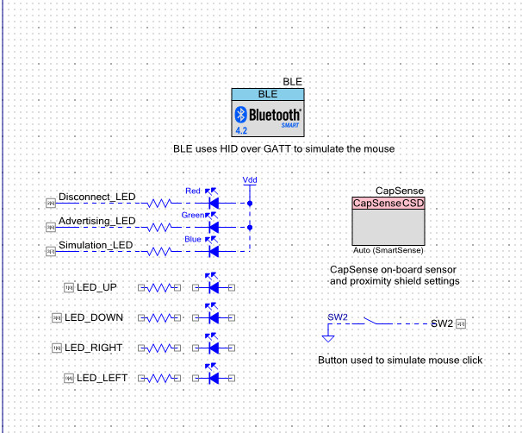
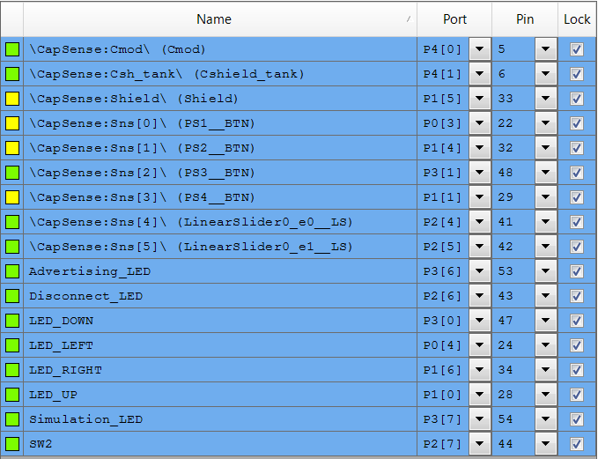
Hardware Design

Slide 4
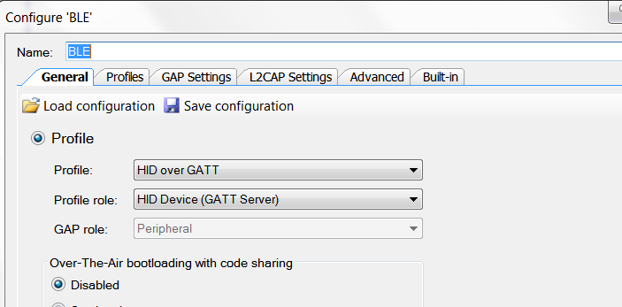
BLE Component Setup
The BLE component is set to HID over GATT.
HID stands for Human Interface Device .
The Generic Attribute Profile (GATT) is how Bluetooth LE transfers data.
These settings allow for a user to interact with the bluetooth-enabled device.

Slide 5
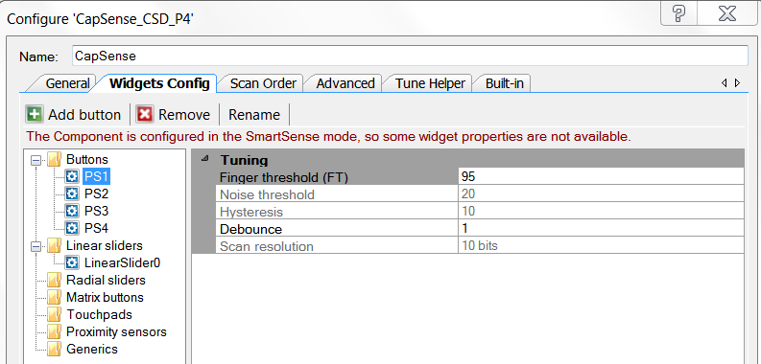
CapSense Component Setup
AutoSense was used in place of a tuner. The project did not have any abnormal requirements so a manual tuner was unnecessary.
Finger Threshold (FT) is the minimum calculated value necessary to activate the sensor. Since the sensors are sensitive, the FT was set to 95 (maximum=100).

Slide 6
Software Diagram
Start
CapSense Measurements
Init
HidsCallBack
BLE Start
SimulateMouse
CyBle_ProcessEvents

Slide 7
Timing Diagram
PS1
Linear Slider
PS3
PS4
LED_UP
LED_DOWN
LED_LEFT
LED_RIGHT
apiResult

Slide 8
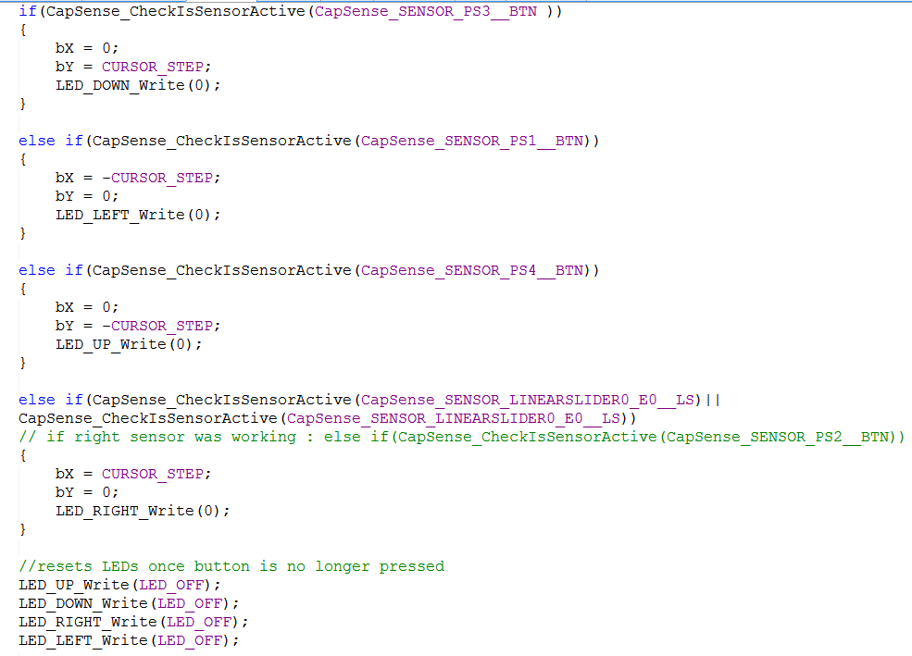
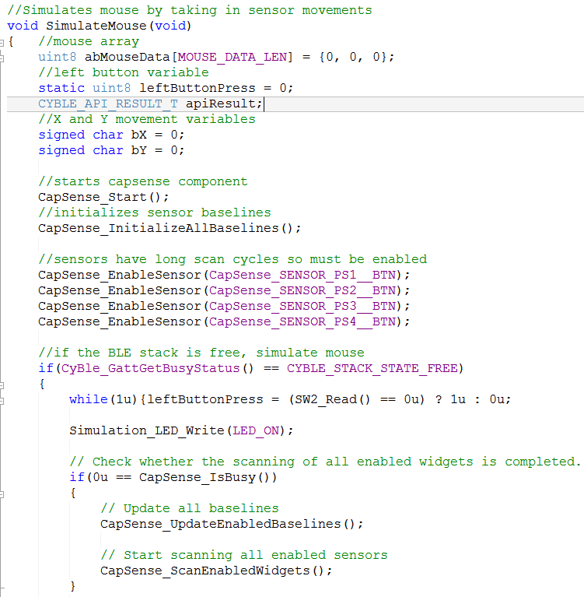
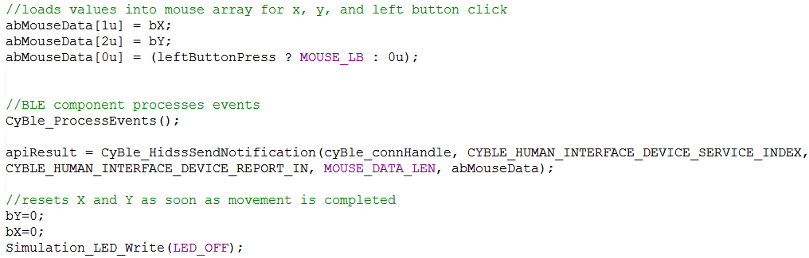
SimulateMouse Function

Slide 9

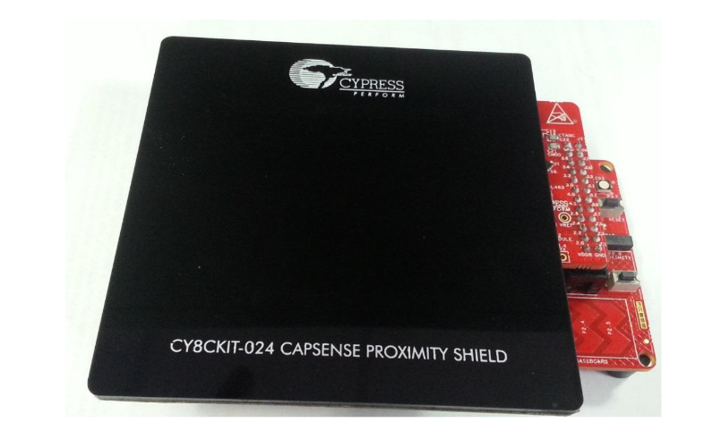
Functionality
Up
Sensor
Mouse Click Button
Left
Sensor
Right
Sensor
Down
Sensor

Slide 10
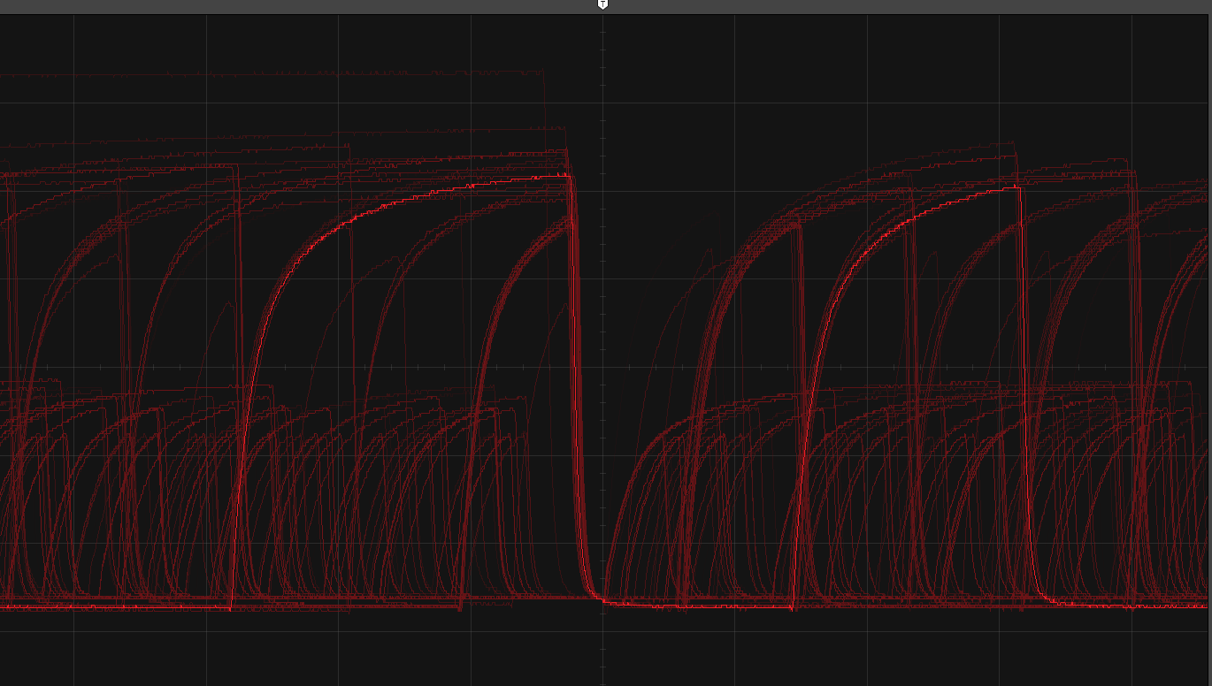
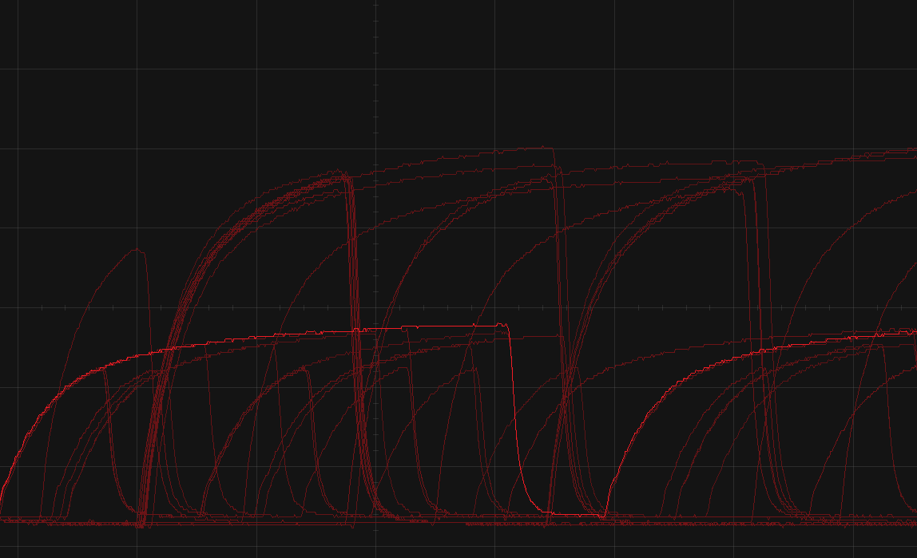
Scope Readings of CapSense Sensor Pin
Pin Reading With No Touch (200ns/div | 500 mV/div)
Pin Reading With Touch
(200ns/div | 500 mV/div)
Voltage decreased by 0.005 mV, which is expected with increased capacitance

Slide 11
Debug Experiences
The pin diagrams that were included with the proximity shield were for a different board with the same name (042).
Once the correct pins were found, even the startup project would not work with the proximity shield. Further testing found that the right sensor was unresponsive.
Unlike other sensors, the CapSense proximity sensors must be enabled in code.
Initially when the mouse would move, it would continue in the direction of the last sensor activated, this was rectified by resetting the x and y variables at the end of the loop.

Slide 12
Conclusion
I learned how to properly implement CapSense proximity sensors in PSoC
I also learned how to use different settings on the Bluetooth component to create an HID.
Next time, I would ensure that all components are working properly before any code is written.
Going further, this could be implemented with a radial sensor (more than just x and y axis movement) and can include a scroll function for mobile use.

Slide 13
References
Cypress.com. (2017). Getting Started With CapSense. Available at: http://www.cypress.com/file/41076/download [Accessed 7 Dec. 2017].

Slide 14
Appendix: main.c
#include "common.h"
#include "hids.h"
uint16 connIntv = CYBLE_GAPP_CONNECTION_INTERVAL_MIN;
uint8 authenticated = 0u;
//callback to receive events from BLE component
void AppCallBack(uint32 event, void* eventParam)
{
CYBLE_API_RESULT_T apiResult;
CYBLE_GAP_BD_ADDR_T localAddr;
CYBLE_GAP_AUTH_INFO_T *authInfo;
switch (event)
{
//GENERAL EVENTS
case CYBLE_EVT_STACK_ON: /* This event received when component is Started */
/* Enter into discoverable mode so that remote can search it. */
apiResult = CyBle_GappStartAdvertisement(CYBLE_ADVERTISING_FAST);
Advertising_LED_Write(LED_ON);
localAddr.type = 0u;
CyBle_GetDeviceAddress(&localAddr);
break;
//GAP EVENTS
case CYBLE_EVT_GAP_AUTH_COMPLETE:
authInfo = (CYBLE_GAP_AUTH_INFO_T *)eventParam;
(void)authInfo;
authenticated = 1;
break;
case CYBLE_EVT_GAP_DEVICE_CONNECTED:
Advertising_LED_Write(LED_OFF);
connIntv = ((CYBLE_GAP_CONN_PARAM_UPDATED_IN_CONTROLLER_T *)eventParam)->connIntv * 5u /4u;
break;
case CYBLE_EVT_GAPC_CONNECTION_UPDATE_COMPLETE:
connIntv = ((CYBLE_GAP_CONN_PARAM_UPDATED_IN_CONTROLLER_T *)eventParam)->connIntv * 5u /4u;
break;
case CYBLE_EVT_GAP_DEVICE_DISCONNECTED:
apiResult = CyBle_GappStartAdvertisement(CYBLE_ADVERTISING_FAST);
break;
//GATT EVENTS
case CYBLE_EVT_GATT_CONNECT_IND:
HidsInit();
break;
}
}
int main()
{
CYBLE_API_RESULT_T apiResult;
CYBLE_STACK_LIB_VERSION_T stackVersion;
CyGlobalIntEnable;
Disconnect_LED_Write(LED_OFF);
Advertising_LED_Write(LED_OFF);
Simulation_LED_Write(LED_OFF);
// Start CYBLE component and register generic event handler
apiResult = CyBle_Start(AppCallBack);
apiResult = CyBle_GetStackLibraryVersion(&stackVersion);
//turn off all leds
LED_UP_Write(1);
LED_DOWN_Write(1);
LED_RIGHT_Write(1);
LED_LEFT_Write(1);
while(1)
{
//BLE processes pending events
CyBle_ProcessEvents();
//ensures ble component is connected and that mousesim is enabled
if((CyBle_GetState() == CYBLE_STATE_CONNECTED) && (suspend != CYBLE_HIDS_CP_SUSPEND) && (authenticated !=0u))
{
if(mouseSimulation == ENABLED)
{
SimulateMouse();
}
}
}
}

Slide 15
Appendix: main.c
CyBle_GetStackLibraryVersion(&stackVersion);
//turn off all leds
LED_UP_Write(1);
LED_DOWN_Write(1);
LED_RIGHT_Write(1);
LED_LEFT_Write(1);
while(1)
{
//BLE processes pending events
CyBle_ProcessEvents();
//ensures ble component is connected and that mousesim is enabled
if((CyBle_GetState() == CYBLE_STATE_CONNECTED) && (suspend != CYBLE_HIDS_CP_SUSPEND) && (authenticated !=0u))
{
if(mouseSimulation == ENABLED)
{
SimulateMouse();
}
}
}
}

Slide 16
Appendix: hids.c
#include "common.h"
#include "hids.h"
uint16 mouseSimulation;
uint8 protocol = CYBLE_HIDS_PROTOCOL_MODE_REPORT; /* Boot or Report protocol mode */
uint8 suspend = CYBLE_HIDS_CP_EXIT_SUSPEND; /* Suspend to enter into deep sleep mode */
//An event callback function to receive service specific events from HID service
void HidsCallBack(uint32 event, void *eventParam)
{
CYBLE_HIDS_CHAR_VALUE_T *locEventParam = (CYBLE_HIDS_CHAR_VALUE_T *)eventParam;
switch(event)
{
case CYBLE_EVT_HIDSS_NOTIFICATION_ENABLED:
//enables mousesimulation
if(CYBLE_HUMAN_INTERFACE_DEVICE_SERVICE_INDEX == locEventParam->serviceIndex)
{
mouseSimulation = ENABLED;
}
break;
case CYBLE_EVT_HIDSS_NOTIFICATION_DISABLED:
//disables mousesimulation
if(CYBLE_HUMAN_INTERFACE_DEVICE_SERVICE_INDEX == locEventParam->serviceIndex)
{
mouseSimulation = DISABLED;
}
break;
}
}
//initializes HID
void HidsInit(void)
{
CYBLE_API_RESULT_T apiResult;
uint16 cccdValue;
/* Register service specific callback function */
CyBle_HidsRegisterAttrCallback(HidsCallBack);
/* Read CCCD configurations from flash */
mouseSimulation = DISABLED;
apiResult = CyBle_HidssGetCharacteristicDescriptor(CYBLE_HUMAN_INTERFACE_DEVICE_SERVICE_INDEX,
CYBLE_HUMAN_INTERFACE_DEVICE_REPORT_IN,
CYBLE_HIDS_REPORT_CCCD, CYBLE_CCCD_LEN, (uint8 *)&cccdValue);
if((apiResult == CYBLE_ERROR_OK) && (cccdValue != 0u))
{
mouseSimulation |= ENABLED;
}
apiResult = CyBle_HidssGetCharacteristicDescriptor(CYBLE_HUMAN_INTERFACE_DEVICE_SERVICE_INDEX,
CYBLE_HIDS_BOOT_MOUSE_IN_REP, CYBLE_HIDS_REPORT_CCCD, CYBLE_CCCD_LEN, (uint8 *)&cccdValue);
if((apiResult == CYBLE_ERROR_OK) && (cccdValue != 0u))
{
mouseSimulation |= ENABLED;
}
}
//Simulates mouse by taking in sensor movements
void SimulateMouse(void)
{ //mouse array
uint8 abMouseData[MOUSE_DATA_LEN] = {0, 0, 0};
//left button variable
static uint8 leftButtonPress = 0;
CYBLE_API_RESULT_T apiResult;
//X and Y movement variables
signed char bX = 0;
signed char bY = 0;
//starts capsense component
CapSense_Start();
//initializes sensor baselines
CapSense_InitializeAllBaselines();
//sensors have long scan cycles so must be enabled
CapSense_EnableSensor(CapSense_SENSOR_PS1__BTN);
CapSense_EnableSensor(CapSense_SENSOR_PS2__BTN);
CapSense_EnableSensor(CapSense_SENSOR_PS3__BTN);
CapSense_EnableSensor(CapSense_SENSOR_PS4__BTN);
//if the BLE stack is free, simulate mouse
if(CyBle_GattGetBusyStatus() == CYBLE_STACK_STATE_FREE)
{
while(1u){leftButtonPress = (SW2_Read() == 0u) ? 1u : 0u;
Simulation_LED_Write(LED_ON);
// Check whether the scanning of all enabled widgets is completed.
if(0u == CapSense_IsBusy())
{
// Update all baselines
CapSense_UpdateEnabledBaselines();
// Start scanning all enabled sensors
CapSense_ScanEnabledWidgets();
}
//checks if each sensor is active, and if it is the cursor moves
//in direction assigned to the sensor
//also turns on corresponding led
if(CapSense_CheckIsSensorActive(CapSense_SENSOR_PS3__BTN ))
{
bX = 0;
bY = CURSOR_STEP;
LED_DOWN_Write(0);
}
else if(CapSense_CheckIsSensorActive(CapSense_SENSOR_PS1__BTN))
{
bX = -CURSOR_STEP;
bY = 0;
LED_LEFT_Write(0);
}
else if(CapSense_CheckIsSensorActive(CapSense_SENSOR_PS4__BTN))
{
bX = 0;
bY = -CURSOR_STEP;
LED_UP_Write(0);
}
else if(CapSense_CheckIsSensorActive(CapSense_SENSOR_LINEARSLIDER0_E0__LS)||
CapSense_CheckIsSensorActive(CapSense_SENSOR_LINEARSLIDER0_E0__LS))
// if right sensor was working : else if(CapSense_CheckIsSensorActive(CapSense_SENSOR_PS2__BTN))
{
bX = CURSOR_STEP;
bY = 0;
LED_RIGHT_Write(0);
}
//resets LEDs once button is no longer pressed
LED_UP_Write(LED_OFF);
LED_DOWN_Write(LED_OFF);
LED_RIGHT_Write(LED_OFF);
LED_LEFT_Write(LED_OFF);
//loads values into mouse array for x, y, and left button click
abMouseData[1u] = bX;
abMouseData[2u] = bY;
abMouseData[0u] = (leftButtonPress ? MOUSE_LB : 0u);
//BLE component processes events
CyBle_ProcessEvents();
apiResult = CyBle_HidssSendNotification(cyBle_connHandle, CYBLE_HUMAN_INTERFACE_DEVICE_SERVICE_INDEX,
CYBLE_HUMAN_INTERFACE_DEVICE_REPORT_IN, MOUSE_DATA_LEN, abMouseData);
//resets X and Y as soon as movement is completed
bY=0;
bX=0;
Simulation_LED_Write(LED_OFF);
}
}
}

Slide 17
Appendix: hids.c
CYBLE_API_RESULT_T apiResult;
//X and Y movement variables
signed char bX = 0;
signed char bY = 0;
//starts capsense component
CapSense_Start();
//initializes sensor baselines
CapSense_InitializeAllBaselines();
//sensors have long scan cycles so must be enabled
CapSense_EnableSensor(CapSense_SENSOR_PS1__BTN);
CapSense_EnableSensor(CapSense_SENSOR_PS2__BTN);
CapSense_EnableSensor(CapSense_SENSOR_PS3__BTN);
CapSense_EnableSensor(CapSense_SENSOR_PS4__BTN);
//if the BLE stack is free, simulate mouse
if(CyBle_GattGetBusyStatus() ==
CYBLE_STACK_STATE_FREE)
{
while(1u){leftButtonPress = (SW2_Read() == 0u) ? 1u : 0u;
Simulation_LED_Write(LED_ON);
// Check whether the scanning of all enabled widgets is completed.
if(0u == CapSense_IsBusy())
{
// Update all baselines
CapSense_UpdateEnabledBaselines();
// Start scanning all enabled sensors
CapSense_ScanEnabledWidgets();
}
//checks if each sensor is active, and if it is the cursor moves
//in direction assigned to the sensor
//also turns on corresponding led
if(CapSense_CheckIsSensorActive(CapSense_SENSOR_PS3__BTN ))
{
bX = 0;
bY = CURSOR_STEP;
LED_DOWN_Write(0);
}
else if(CapSense_CheckIsSensorActive(CapSense_SENSOR_PS1__BTN))
{
bX = -CURSOR_STEP;
bY = 0;
LED_LEFT_Write(0);
}
else if(CapSense_CheckIsSensorActive(CapSense_SENSOR_PS4__BTN))
{
bX = 0;
bY = -CURSOR_STEP;
LED_UP_Write(0);
}
else if(CapSense_CheckIsSensorActive(CapSense_SENSOR_LINEARSLIDER0_E0__LS)||
CapSense_CheckIsSensorActive(CapSense_SENSOR_LINEARSLIDER0_E0__LS))
// if right sensor was working : else if(CapSense_CheckIsSensorActive(CapSense_SENSOR_PS2__BTN))
{
bX = CURSOR_STEP;
bY = 0;
LED_RIGHT_Write(0);
}
//resets LEDs once button is no longer pressed
LED_UP_Write(LED_OFF);
LED_DOWN_Write(LED_OFF);
LED_RIGHT_Write(LED_OFF);
LED_LEFT_Write(LED_OFF);
//loads values into mouse array for x, y, and left button click
abMouseData[1u] = bX;
abMouseData[2u] = bY;
abMouseData[0u] = (leftButtonPress ? MOUSE_LB : 0u);
//BLE component processes events
CyBle_ProcessEvents();
apiResult = CyBle_HidssSendNotification(cyBle_connHandle, CYBLE_HUMAN_INTERFACE_DEVICE_SERVICE_INDEX,
CYBLE_HUMAN_INTERFACE_DEVICE_REPORT_IN, MOUSE_DATA_LEN, abMouseData);
//resets X and Y as soon as movement is completed
bY=0;
bX=0;
Simulation_LED_Write(LED_OFF);
}
}
}

Slide 18
Appendix: hids.c
LED_RIGHT_Write(0);
}
//resets LEDs once button is no longer pressed
LED_UP_Write(LED_OFF);
LED_DOWN_Write(LED_OFF);
LED_RIGHT_Write(LED_OFF);
LED_LEFT_Write(LED_OFF);
//loads values into mouse array for x, y, and left button click
abMouseData[1u] = bX;
abMouseData[2u] = bY;
abMouseData[0u] = (leftButtonPress ? MOUSE_LB : 0u);
//BLE component processes events
CyBle_ProcessEvents();
apiResult = CyBle_HidssSendNotification(cyBle_connHandle, CYBLE_HUMAN_INTERFACE_DEVICE_SERVICE_INDEX,
CYBLE_HUMAN_INTERFACE_DEVICE_REPORT_IN, MOUSE_DATA_LEN, abMouseData);
//resets X and Y as soon as movement is completed
bY=0;
bX=0;
Simulation_LED_Write(LED_OFF);
}
}
}

Slide 19
Appendix: commons.h and hids.h
#include <project.h>
/***************************************
* Constants
***************************************/
/* Mouse movement states */
#define MOUSE_DOWN (0u)
#define MOUSE_LEFT (1u)
#define MOUSE_UP (2u)
#define MOUSE_RIGHT (3u)
#define MOUSE_LB (1u)
#define MOUSE_DATA_LEN (3u)
//cursor step size
#define CURSOR_STEP (2)
/***************************************
* Function Prototypes
***************************************/
void HidsCallBack(uint32 event, void *eventParam);
void HidsInit(void);
void SimulateMouse(void);
/***************************************
* External data references
***************************************/
extern uint16 mouseSimulation;
extern uint8 protocol;
extern uint8 suspend;
extern uint32 mouseTimer;
#include <project.h>
#include <stdio.h>
#define ENABLED (1u)
#define DISABLED (0u)
/***************************************
* API Constants
***************************************/
#define LED_ON (0u)
#define LED_OFF (1u)
/***************************************
* External Function Prototypes
***************************************/
void ShowValue(CYBLE_GATT_VALUE_T *value);
void Set32ByPtr(uint8 ptr[], uint32 value);
void ShowError(void);
void HandleLeds(void);

